Slide 1
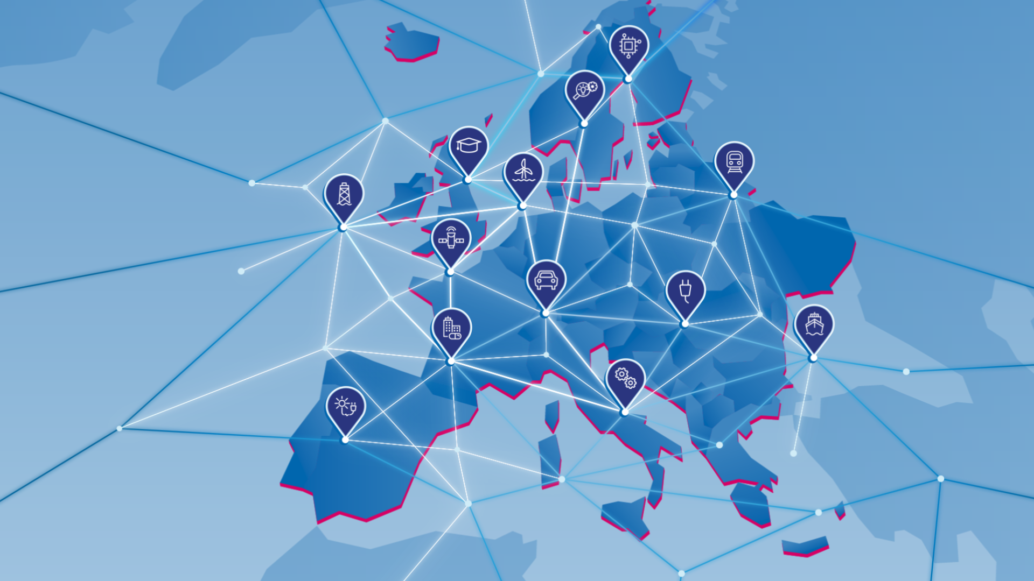
Global Sentiment Survey on Europe 2026
Short report
Frankfurt am Main, September 21, 2026

Slide 2
Who did we speak to?
13
100+
1,200
67%
33%
non-European markets
employees
respondents
invested in Europe
not yet invested, but plan or consider investing within next 5 years
minimum company size
(senior leaders and decision-makers)
across three regions
Where are they based?
Industries
APAC – 50%
China (incl. Hong Kong) – Japan – Singapore – India – Australia – South Korea - Taiwan
Americas – 33%
USA – Canada – Mexico – Brazil
Middle East – 17%
United Arab Emirates – Saudi Arabia
Company Size
13% – 100-249 | 18% – 250-499 | 25% – 500-999 | 44% – 1000+

Slide 3
International companies show growing interest in Europe
KEY MESSAGES
Europe is the top investment region among surveyed business leaders
Germany ranks as Europe’s number one destination for non-European investors
Europe earns praise for its political and economic stability and innovative strength, but faces criticism over cross-border frictions, costs, slow approvals and permitting procedures

Slide 4
1. Business leaders put Europe ahead of America and Asia
Region attractiveness, in %
Already invested in Europe, in %
Not yet invested in Europe but planning to, in %
KEY TAKEAWAY
Europe stands out as the most attractive region (35%), ahead of APAC (24%) and North America (19%). Companies already invested in Europe are its strongest advocates: 45% rank it as the most attractive region, versus just 15% of non-investors, who favour APAC (44%).
Q: Which of the following regions is currently the most attractive for your business?

Slide 5
2. Confidence in Europe is growing
Overall shift, in %
By investor domicile, in %*
KEY TAKEAWAY
KEY TAKEAWAY
81% say Europe has become much or somewhat more important compared to three years ago.
The rise is steepest among Middle East investors: 89% say “much more” or “somewhat more important”, compared to 85% in the Americas and 77% in APAC.
Q: Compared to 3 years ago, has Europe become more or less important in your investment decisions?
*5-point scale from Much more important (5) to Much less important (1) 7 Top-2-box responses shown

Slide 6
3. Europe is seen as resilient in uncertain times
Overall shift, in %
By investor domicile, in %*
KEY TAKEAWAY
KEY TAKEAWAY
71% perceive Europe as resilient in the face of economic and geopolitical challenges. Only 10% consider it not resilient.
Perceptions of Europe’s resilience are strongest in Middle East, where 82% rate it as highly or fairly resilient, followed by APAC at 71% and the Americas at 65%.
Q: How resilient is Europe as a business destination amid economic and geopolitical uncertainty?
*5-point scale from Highly resilient (5) to Not resilient at all (1) / Top-2-box responses shown

Slide 7
4. Investors are increasingly keen to venture into Europe
Current and planned investment in Europe
Not invested, plan or consider 5y
Invested, expand 5y
Invested, no expansion
KEY TAKEAWAY
Investment momentum in Europe is strong. Most companies either plan to expand existing operations over the next five years (61%) or are planning or actively considering entering the European market for the first time (33%). Only 6% do not intend to invest further.
Q: Which of the following best describes your company's current and planned involvement in Europe?

Slide 8
5. Europe remains an attractive consumer market, while its industrial importance continues to grow
Current type of investment, in %*
Increasing importance for production, R&D
and supply chain stability and...
Not very important
Not important at all
Somewhat important
Very important
… as a consumer market
Not very important
KEY TAKEAWAY
Somewhat important
Although only 19% of companies already active in Europe currently manufacture there, 92% of all respondents say Europe will be important as a production location over the next three to five years.
Very important
Q: Which of the following types of business activities does your company currently have in Europe?
*of companies already invested in Europe, multiple answer question
Q: How important is Europe for your company's growth over the next 3–5 years in each of the following roles? As an industrial and production location (manufacturing, R&D, supply chains) / As a consumer market (demand for your products/services)

Slide 9
6. Europe scores highly on growth and innovation
Europe's strengths*
74%
71%
Growth opportunities
Innovation
70%
68%
International relationships
Economic & market stability
KEY TAKEAWAY
Europe’s appeal is driven by growth potential, not just stability. Respondents identify strong or moderate advantages for Europe compared to other regions in growth opportunities (74%) its capacity for innovation – particularly in combination with the potential of AI (71%), followed by international relationships (70%) and economic and market stability (68%).
Q: For each of the following aspects, please indicate how you evaluate Europe compared to other regions as an investment destination.
*Top-2-box responses shown: “strong advantage” and “moderate advantage”, 6 point scale

Slide 10

7. Germany is Europe’s investment magnet
Preferred investment destination, in %
Germany’s strengths by factor, in %
ø54%
KEY TAKEAWAY
​Germany achieves high scores for infrastructure and logistics; its capacity for innovation – particularly in combination with AI; industrial capabilities; skilled workforce; and market growth and scaling.
Q: In which countries across Europe do you plan to invest or expand your business in the near future?
Which of the countries you selected are the most important ones? Please rank your Top 3.
Q: Which of these European countries do you think are strong across the following differentiation factors?

Slide 11
8. Europe’s biggest obstacle is Europe itself
Cross-border frictions weaken Europe’s appeal
Overall impact, in %
By investor domicile, in %*
KEY TAKEAWAY
KEY TAKEAWAY
Overall, 43% of respondents say they have a large or very large impact, while a further 42% say they have some impact. Only 15% report little or no impact.​
Perceived impact varies significantly by region. Frictions are felt most strongly in Middle East, where 86% report a large or very large impact, compared with 49% in the Americas and 26% in APAC.
Q: To what extent do cross-border frictions reduce Europe’s attractiveness?
Q: To what extent do cross-border frictions reduce Europe’s attractiveness?
*Top-2 box responses shown

Slide 12
8. Europe’s biggest obstacle is Europe itself
Four priority areas for strengthening Europe’s competitiveness
Perceived barriers – score under 50%*
42%
44%
Labour cost competitiveness
Tax environment
47%
47%
Energy cost competitiveness
Approval & permitting speed
KEY TAKEAWAY
These are the only four areas in which fewer than 50 percent see Europe as having an advantage over other regions. Together, they provide priorities for a focused competitiveness agenda.
Q: Please indicate how you evaluate Europe compared to other regions as an investment destination
*Top-2 box responses shown

Slide 13
Europe starts from a position of strength
NEXT STEP: Turn confidence into growth
Protect Europe's strengths
Stability, openness and trusted institutions
Complete the Single Market
Less fragmentation, more scale
Mobilise private capital
For technology, infrastructure and security
Lead in industrial AI
Turn innovation into productivity
Deliver with speed
From ambition to execution
13

